Slide 1

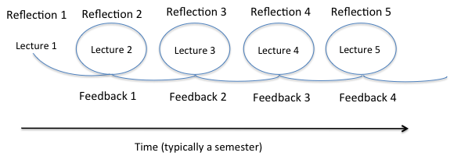

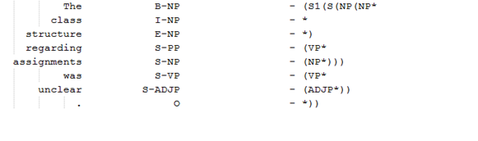

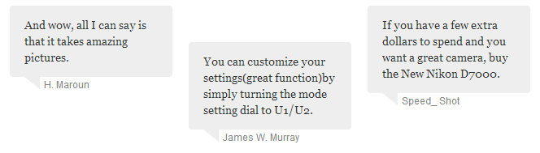
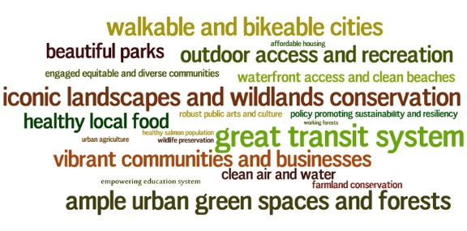

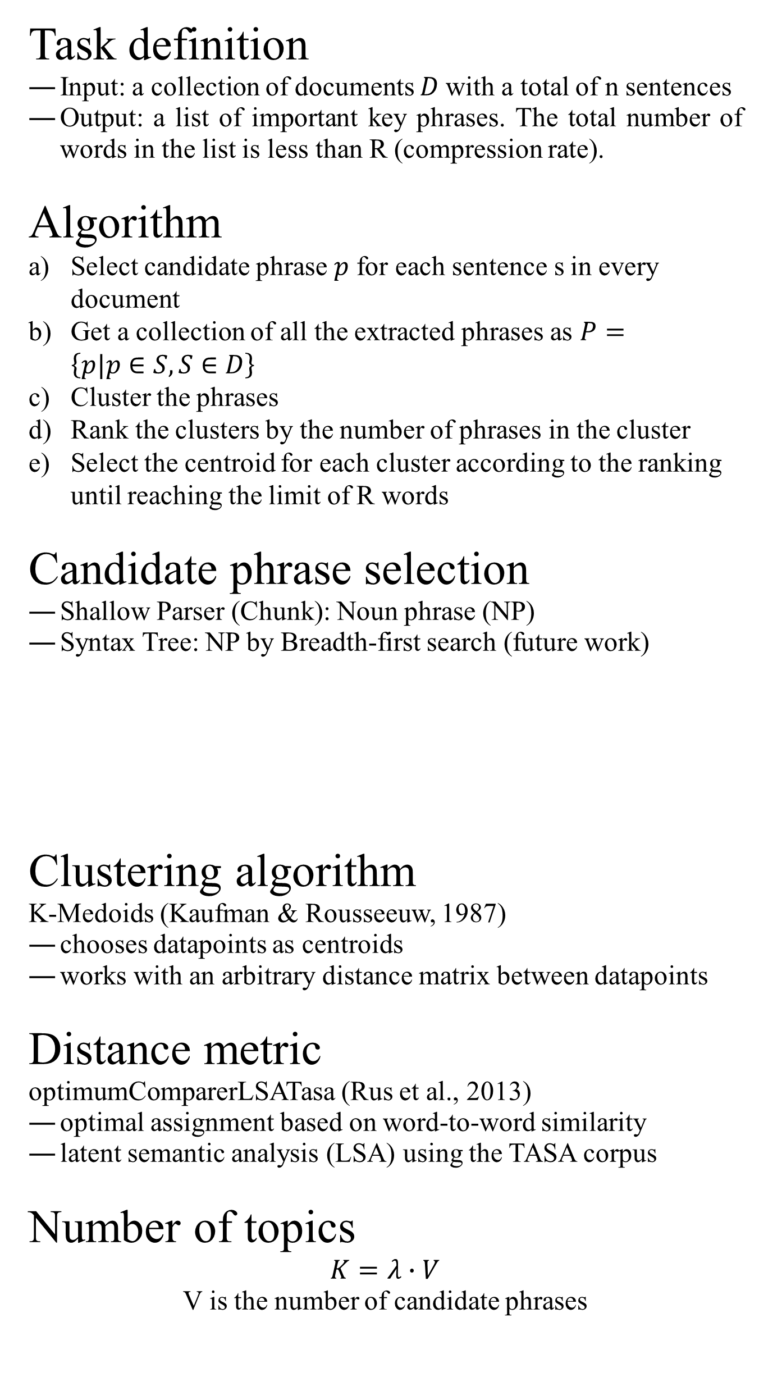

Automatic Summarization of Student Reflections Based on Phrase Clustering
Wencan Luo, Diane Litman
Key phrases: automatic phrase summarization, phrase clustering, student reflections
Motivation
Methods
Corpus
Results
We hope you find this template useful! This one is set up to yield a 48x36” (4x3’) horizontal poster.
Rouge scores for Muddiest Point
Best result ($λ$=0.3)
Student reflection
“recapture experience, think about it, mull it over and evaluate it” (Boud et al., 2013)
showed a significant positive correlation to the learning gains (Menekse & Chi, 2013)
To enhance the interaction between students and instructors via reflections, it needs
A timely feedback
A challenge for instructors
to have a general understanding (summarization) about students’ feedback before next lecture
especially for big class (STEM courses, Massive Open Online Courses)
Phrase summarization is better than sentence summarization
The students’ reflections tend to be short.
It fits better on small screens (mobile devices).
This condensed form can provide more coverage.
It is easy to understand via phrase cloud.
Phrase summarization based on clustering
similar phrases will be grouped (minimize the redundancy)
different phrases will be split (maximize the coverage)
distances are measured by semantic similarity
* different surface forms (i.e. in morphology or synonym)
Overview
Participants
53 undergraduate engineering students (19 were female)
an introductory materials science and engineering class
Reflection collection
Students were asked to complete the questionnaire (Fig. 2) at the end of each class during the entire semester.
Data size
900+ feedbacks for each point of reflection
25 lectures during the semester
12 of the lectures have manual summaries from the TA
Candidate phrase selection
Phrase clustering
Centroid phrase extraction
1
2
Type of method | R1 | R2 | R-SU4
Unigram | 0.322 | 0.016 | 0.077
Keyphrase | 0.227 | 0.076 | 0.053
Phrase Clustering | 0.367† | 0.101* | 0.096†
3
* indicates that it is significant different from the Unigram baseline (p<0.05)
† indicates that it is significant different from the Keyphrase baseline (p<0.05)
Task definition
Input: a collection of documents $D$with a total of n sentences
Output: a list of important key phrases. The total number of words in the list is less than R (compression rate).
Algorithm
Select candidate phrase $p$ for each sentence s in every document
Get a collection of all the extracted phrases as $P=\left\{p|p∈S, S∈D\right\}$
Cluster the phrases
Rank the clusters by the number of phrases in the cluster
Select the centroid for each cluster according to the ranking until reaching the limit of R words
Candidate phrase selection
Shallow Parser (Chunk): Noun phrase (NP)
Syntax Tree: NP by Breadth-first search (future work)
Clustering algorithm
K-Medoids (Kaufman & Rousseeuw, 1987)
chooses datapoints as centroids
works with an arbitrary distance matrix between datapoints
Distance metric
optimumComparerLSATasa (Rus et al., 2013)
optimal assignment based on word-to-word similarity
latent semantic analysis (LSA) using the TASA corpus
Number of topics
$$K=λ∙V$$
V is the number of candidate phrases
Sample output
Manual summary for one lecture (muddiest point):
[1] In class activities (Specially the first activity)
[2] Atomic Packing Factor and relation between a&r
[3] Which structure produce which materials’ properties and how unit cell affects the processing
Automated summary:
Figure 1. A continuous feedback cycle between students and instructors
Figure 2. The questionnaire to collect reflection feedbacks after each class
Unigram | Keyphrase Extraction | Phrase Clustering
unit | Structure characteristics | how unit cell
atomic | atomic packing | our activities
cell | packing factor | the material
activity | unit cell | Which structures
confusing | Whethere we describe | structure characteristics
factor | unit cell lengths | the math
activities | describe unit cell | atomic packing factor
processing | lengths in terms | apf
packing | describe unit | the properties
properties | Caculating structure characteristics | a little more explanation
length | atomic | the exact difference
apf | slides How unit | different crystal systems
….
Summary
Figure 3. The distribution of number of words in students’ reflections: Point of Interest (POI), Muddiest Point (MP), and Learning Point (LP)
A new phrase summarization approach by clustering
better than unigram and keyphrase extraction
Future work
other clustering methods (hierarchical clustering, spectral clustering or Affinity Propagation)
human evaluation
This work is supported by Pitt’s Learning Research & Development Center, through a grant to Drs. Muhsin Menekse, Diane Litman, & Jingtao Wang
Chunk
Syntax
Evaluation
Related Work
Metric
ROUGE scores (widely used in ATS)
Overlap between human summary and automated summary
$$ROUGE–N=\frac{\sum_{S∈\left\{ReferenceSummaries\right\} }{\sum_{{gram}_{n}∈S}{{Count}_{match}\left({gram}_{n}\right)}}}{\sum_{S∈\left\{ReferenceSummaries\right\} }{\sum_{{gram}_{n}∈S}{Count\left({gram}_{n}\right)}}}$$
Baseline
Unigram
* a list of most frequent words (unigram), weighting by tf-idf
Keyphrase extraction
* the state-of-art keyphrase extraction implemented by Maui (Medelyan et al., 2009)
Bibliography
Automatic text summarization (ATS)
Word level
Sentence level
Phrase level
Key phrase extraction (Hasan & Ng, 2014)
Boud, D., Keogh, R., & Walker, D. (2013). Reflection: Turning Experience Into Learning (p. 170). Routledge
Hasan, K. S., & Ng, V. (2014). Automatic Keyphrase Extraction: A Survey of the State of the Art. ACL 2014.
Kaufman, L., & Rousseeuw, P. (1987). Clustering by means of medoids (pp. 405–416). North-Holland.
Medelyan, O., et al. (2009). Human-competitive tagging using automatic keyphrase extraction. EMNLP 2009.
Menekse, M., & Chi, M.T.H. (2013). The effectiveness of knowledge co-construction on pairs’ learning outcomes. AERA 2013.
Rus, V., Lintean, et al. (2013). SEMILAR: The Semantic Similarity Toolkit. ACL 2013.

